Slide 1
Python interview Questions
Designed by: Saqib Sayab Khan

Slide 2
Q1.list out the inheritance styles in Django?
The inheritance styles in Django are 3 in number,
Abstract Base classes:
This inheritance styles is used by the developer when they parents class to retain the data which you do not want to type out for every single child model.
Multi-Table inheritance:
This inheritance style is used if you want to subclass on an existing model and each of the models to have its own database table.
Proxy models:
This inheritance style allows the user to modify the python level behavior without actually modifying the model’s field.

Slide 3
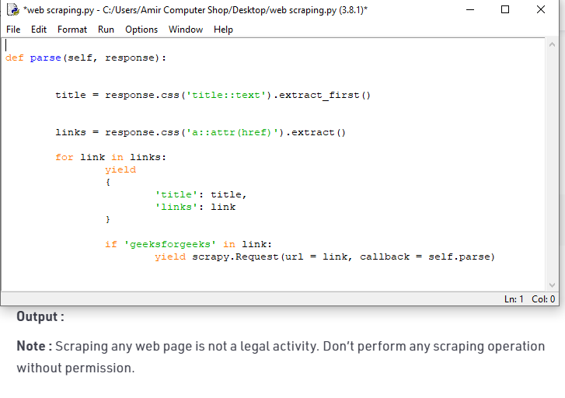
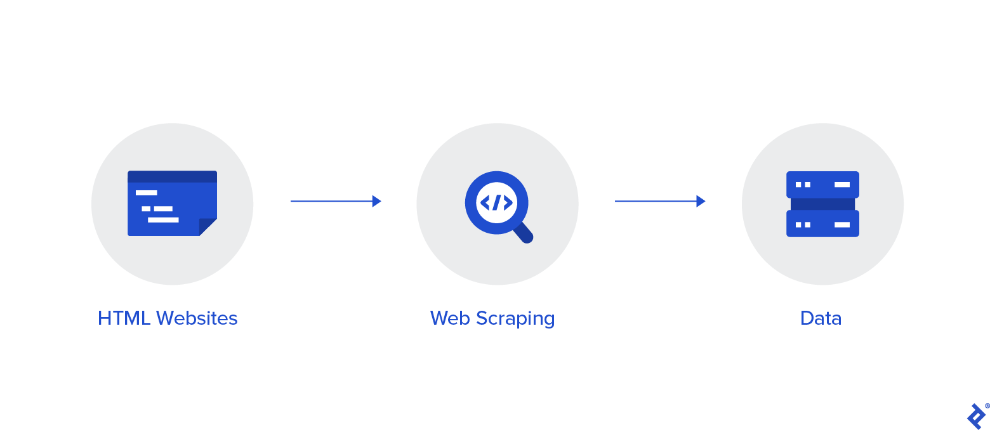
Q3.web scraping using python
Web scraping has been used to extract data from websites almost from the time the World Wide Web was born. In the early days, scraping was mainly done on static pages – those with known elements, tags, and data.
More recently, however, advanced technologies in web development have made the task a bit more difficult. In this article, we’ll explore how we might go about scraping data in the case that new technology and other factors prevent standard scraping.
Traditional Data Scraping
As most websites produce pages meant for human readability rather than automated reading, web scraping mainly consisted of programmatically digesting a web page’s mark-up data (think right-click, View Source), then detecting static patterns in that data that would allow the program to “read” various pieces of information and save it to a file or a database.

Slide 4
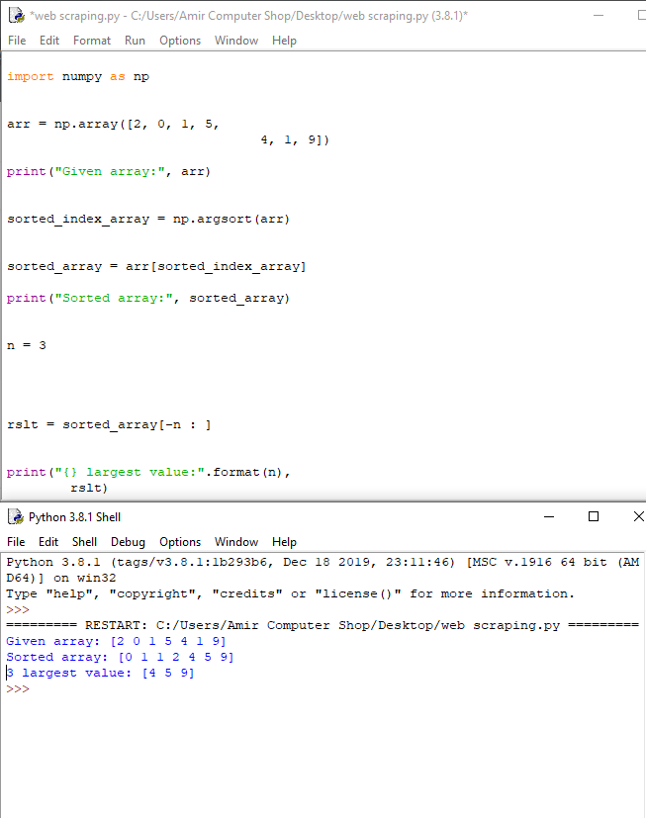
Q4.How to get indices of N maximum calues in a Numpy Array?
For getting n-largest values from a NumPy array we have to first sort the NumPy array using numpy.argsort() function of NumPy then applying slicing concept with negative indexing.

Slide 5
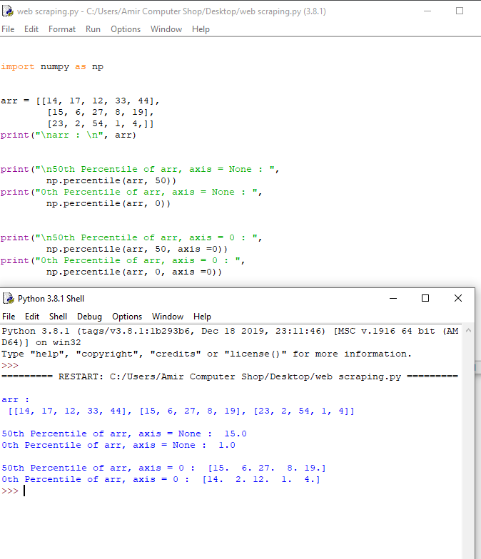
Q5.How do i calculate Percentiles With Numpy/Python?
numpy.percentile()function used to compute the nth percentile of the given data (array elements) along the specified axis.

Slide 6
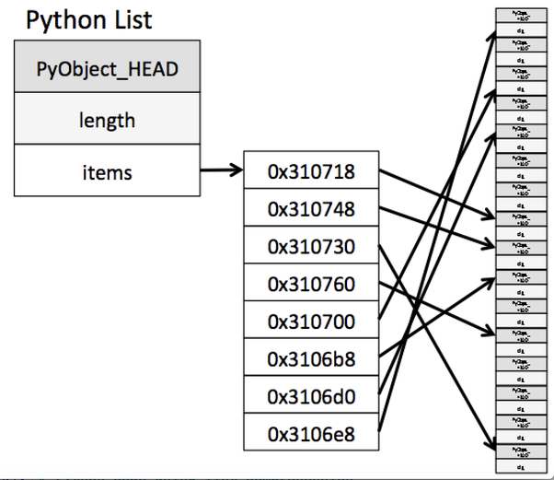
Q6.What advantages does Numpy arrays offers over(nested)Python lists?
First, it’s worth understanding what a Python list looks like under the hood. There’s a header, which keeps track of the length of the list, and also has a reference to the list. The list is actually a list of references to the items, which are likely not contiguous:
Therefore, iterating through the list is somewhat expensive, in that there is an extra level of indirection. Jumping around memory to retrieve the items is of course slower than reading contiguous data from memory.
Which brings us to numpy arrays. numpy is written in C, so numpy arrays are really C data structures under the hood. There is still a Python header:

Slide 7
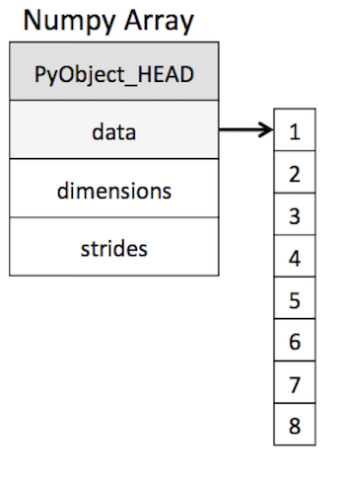
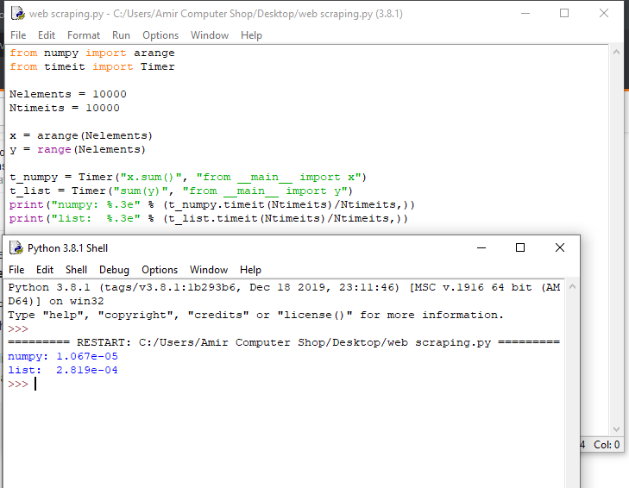
but the elements of the array are contiguous In memory, just as they are in C. This makes iteration much faster. In addition to speed, numpy arrays use less memory than Python lists. For large arrays, this matters–using numpy may in fact make it possible to store all your data in memory in a case where Python lists would be too large.

Slide 8
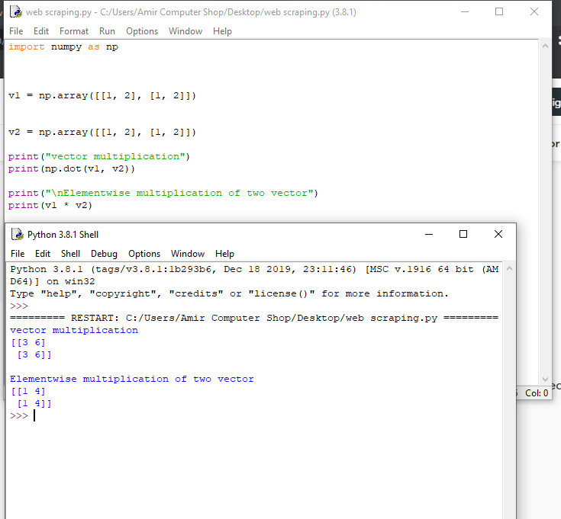
Q7.what is the difference between Numpy and Scipy?
NumPy and SciPy are the two most important libraries in Python. The operations are relative and hence contrasting. Both libraries have a wide range of functions. The prerequisite of working with both the libraries is to understand the python basics.
NumPy stands for Numerical Python while SciPy stands for Scientific Python. Both of their functions are written in Python language.
We use NumPy for homogenous array operations. We use NumPy for the manipulation of elements of numerical array data. NumPy hence provides extended functionality to work with Python and works as a user-friendly substitute.
SciPy is the most important scientific python library. It consists of a variety of sub-packages and hence has a collection of functions. The sun-packages support functions including clustering, image processing, integration, etc. It is a very consistent package and hence useful for numerical computations in Python.

Slide 9
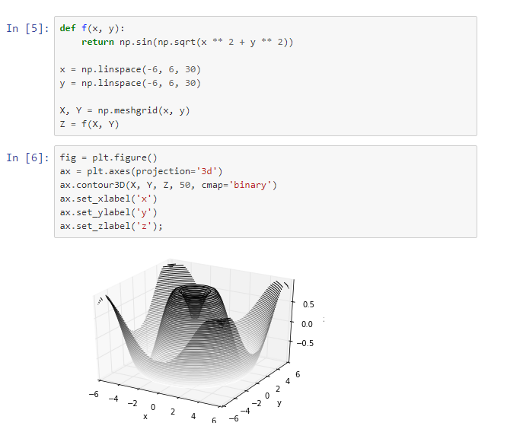
Q8.How do i make 3D plots/visualization using Numpy/scipy?
Like 2D plotting, 3D graphics is beyond the scope of NumPy and SciPy, but just as in this 2D example, packages exist that integrate with NumPy. Matplotlib provides primary 3D plotting in
the mplot3d subpackage, whereas Mayavi produces a wide range of high-quality 3D visualization features, utilizing the powerful VTK engine.

Slide 10
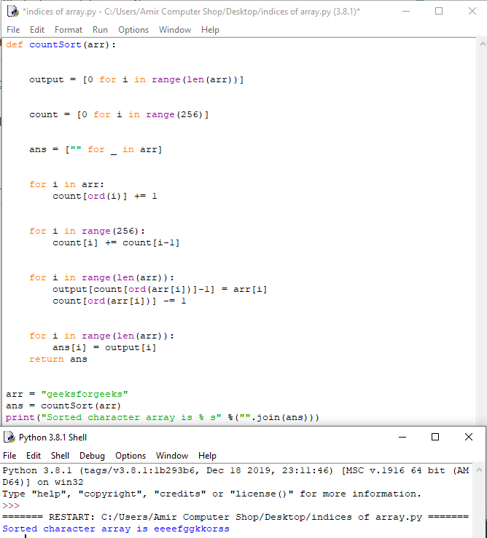
Q9.how do I find the indices of an array where some condition is true?
Counting sort is a sorting technique based on keys between a specific range. It works by counting the number of objects having distinct key values (kind of hashing). Then doing some arithmetic to calculate the position of each object in the output sequence

Slide 11
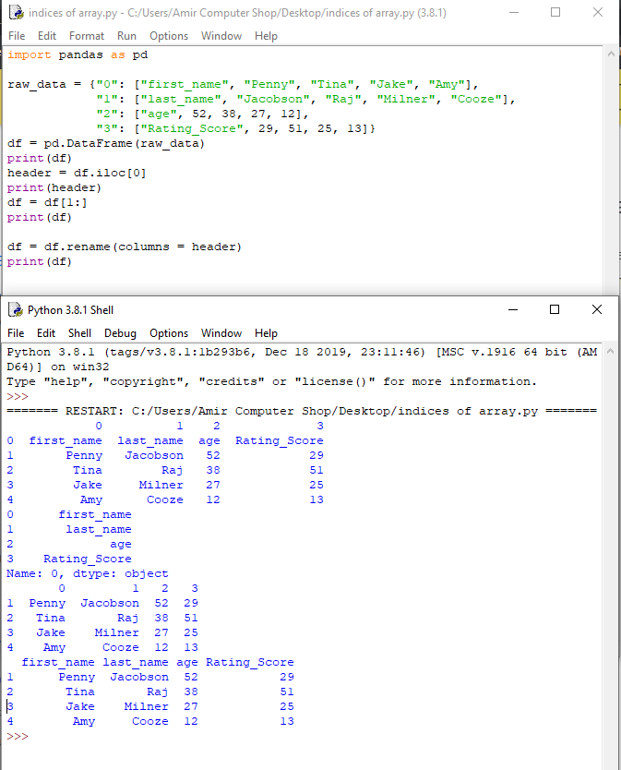
Q10.how to rename column headers in pandas DataFrame?
Have you ever tried to rename a column in pandas dataframe by header. That is setting first element of column as the name of the column.
So this is the recipe on how we can rename column header of a Pandas DataFrame.

Slide 12
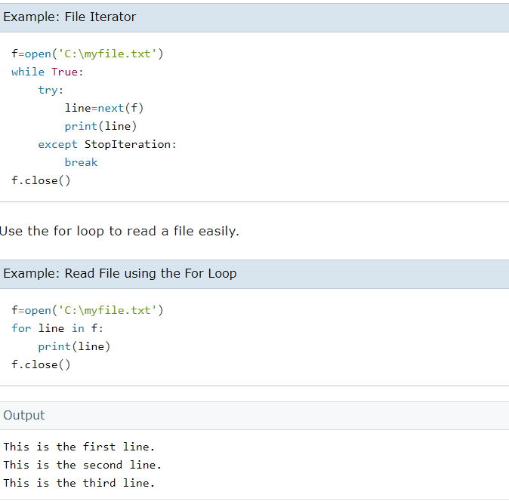
Q11.write a program to read and write the binary data using python?
Given a binary file that contains some sentences (space separated words), let’s write a Python program to modify or alter any particular word of the sentence.
Approach: Step 1: Searching for the word in the binary file. Step 2: While searching in the file, the variable “pos” stores the position of file pointer record then traverse(continue) reading of the record. Step 3: If the word to be searched exists then place the write pointer (to ending of the previous record) i.e. at pos. Step 4: Call write() function to take the new record. Step 5: Write the new object at the position “pos” and hence the record is updated and print “record successfully updated”. Step 6: If the word does not exists then print “record not found”.

Slide 13
Thank you!

